Slide 1


Financial Education Crew
Assignment 4

Slide 2


Quick Overview of Nanhi Kali
Nanhi Kali is a non-governmental organization (NGO) in India that works to provide education to underprivileged girl children in the country. The organization was founded in 1996 by Anand Mahindra, the chairman of the Mahindra Group, and his wife, Anuradha Mahindra.
Notes:
Nanhi Kali is a non-governmental organization (NGO) in India that works to provide education to underprivileged girl children in the country. The organization was founded in 1996 by Anand Mahindra, the chairman of the Mahindra Group, and his wife, Anuradha Mahindra.
Nanhi Kali's mission is to ensure that every girl child receives an education that empowers her to achieve her full potential. They work towards this by providing academic support, material support, and community engagement to the girls they support. They offer academic support through access to an adaptive learning software via digital tablets. The organization has impacted the lives of over 5,00,000 girls across 20 states in India so far.

Slide 3
Meeting Agenda:
Who is FEC?
Why Choose FEC?
Moving Forward
Conclusion

Slide 4
Who is FEC?

Slide 5
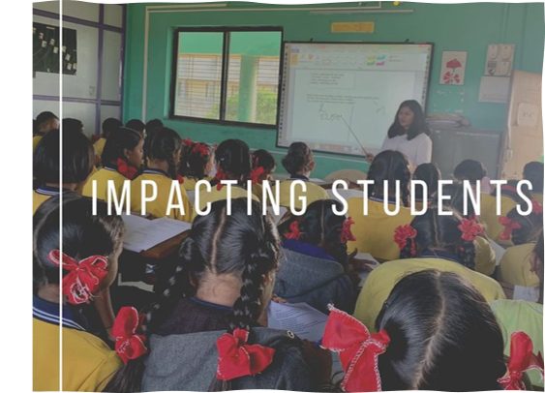
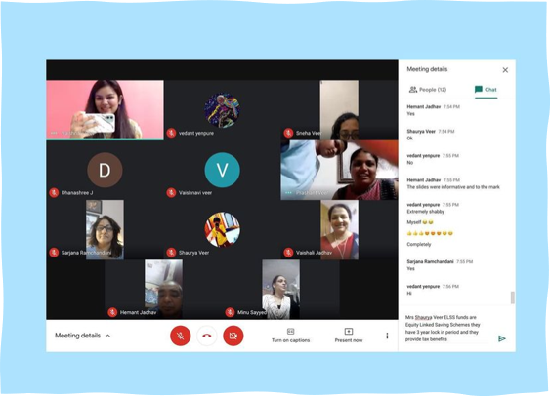
About Financial Education Crew
Notes:
One of the key values of our startup is to provide high-quality, interactive financial education to young adults and women in India. We believe that financial education is a critical component of enabling financial wellbeing and freedom, and we are committed to making this education accessible to everyone, regardless of their background or financial situation.
We are excited to explore a potential strategic alliance with Nanhi Kali because we believe that our values align closely with those of your organization. Nanhi Kali is focused on empowering underprivileged girls in India through education, and we believe that financial education is an important part of this process. By providing young girls with access to education, Nanhi Kali is helping to break down barriers and create opportunities for these girls to achieve their full potential.
Our commitment to financial education aligns perfectly with Nanhi Kali's mission to empower underprivileged girls in India through education. By working together, we can create a powerful partnership that will make a real difference in the lives of underprivileged girls in India. We believe that our unique approach to financial education, which is both interactive and engaging, will be particularly effective for young girls who are just beginning to learn about financial concepts.
We are confident that a strategic alliance between our two organizations can create a lasting impact in the lives of underprivileged girls in India. By combining our expertise and resources, we can empower young girls to achieve financial independence and break the cycle of poverty.

Slide 6
The Problem Around Spending
Overspending
No Savings
What is a Budget?
Low or No Investments
Low Knowledge
Anxiety

Slide 7
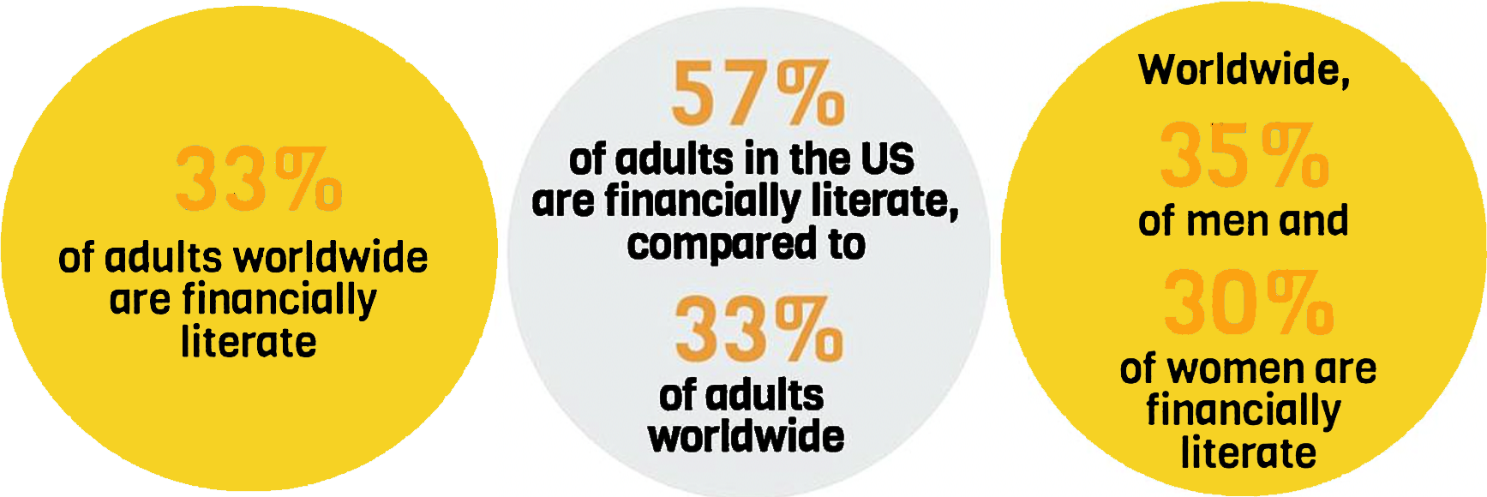
Looking at the Problem at World Level

Slide 8
Root Cause of this Problem
We are never taught about money in school
We never learn the basics of saving, investment and budgeting in early ages.

Slide 9

What the Course Offers
Understand how to manage personal finance
Money and investing
Personal financial planning
Budgeting
Principle of compound interest
How to manage debt
Profitable savings techniques
Time Value of Money
Fun interactive worksheets to understand all the topics better

Slide 10
Why choose FEC?

Slide 11

How FEC is Different
Targeting and making the course particularly for those 2 segments
Fun interactive activities and quizzes.
We have created our own budget worksheet which was tested by 650 people in pilot run.
Team will have young people so we can connect better with them.
Notes:
The financial education landscape in India is highly competitive, with many players offering similar services. However, the Financial Education Crew differentiates itself by focusing on the unique needs and preferences of young girls. Our approach is tailored to the specific challenges and opportunities faced by young girls in India, and we offer a range of innovative solutions to address their financial education needs.
Our key points of differentiation include:

Slide 12
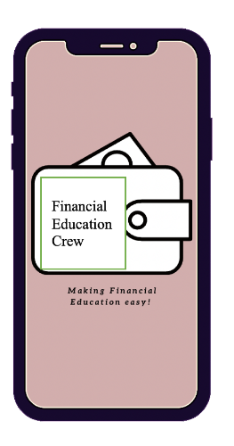
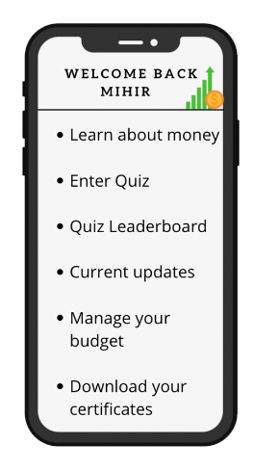
Age Appropriate Curriculum
Interactive Learning
We use engaging, age-appropriate content that is tailored to the needs and preferences of our target audience, making it easier for them to understand and apply financial concepts.
Our platform includes a range of interactive features such as quizzes, games, and simulations that help girls learn and practice financial skills in a fun and engaging way.
Notes:
Age-appropriate curriculum: Financial Education Crew's financial education curriculum is designed specifically for young girls in India. We use engaging, age-appropriate content that is tailored to the needs and preferences of our target audience, making it easier for them to understand and apply financial concepts.
Interactive learning: We believe that financial education should be fun and interactive. Our platform includes a range of interactive features such as quizzes, games, and simulations that help girls learn and practice financial skills in a fun and engaging way.

Slide 13
Personalized Coaching
Community Engagement
Our platform includes personalized coaching and support features that help girls set financial goals and develop customized plans to achieve them.
We work closely with schools, parents, and community organizations to create a supportive environment that fosters financial literacy and responsibility.
Notes:
Personalized coaching: We recognize that every girl is unique, and that financial education needs to be tailored to individual needs and circumstances. Our platform includes personalized coaching and support features that help girls set financial goals and develop customized plans to achieve them.
Community engagement: Financial Education Crew believes that financial education is not just an individual effort, but also a community effort. We work closely with schools, parents, and community organizations to create a supportive environment that fosters financial literacy and responsibility.

Slide 14

FEC is different:
Tailored approach
Interactive learning features
Personalized coaching
Community engagement
Notes:
In summary, Financial Education Crew is a financial education startup that differentiates itself by focusing on the unique needs and preferences of young girls in India. Our tailored approach, interactive learning features, personalized coaching, and community engagement make us the ideal partner for organizations like Nanhi Kali that are committed to empowering young girls and promoting financial literacy.

Slide 15
Moving Forward
Notes:
ofcourse recognizing what we got to offer is not enough. We need to make sure that we are providing solutions and not just ideas. In such a sceario, market research and user research is key that makes or breaks a successful organization

Slide 16

Conduct the Research
Develop Key Differentiators
Interviews
Feedback Survey
Train Teachers
Create Relevant Content
Accredited Courses
Industrially Recognized Certifications
Notes:
This is also part of the strategy which we would follow which is maket research, user research, testing and finally product launch.Interviews and feedback surveys will better help us analyze the strengths and weaknesses of your offering, we can better cater towards solving the problem on hand and creating a bigger impact. The result of which would allow us to develop the key differentiators which will put our product on the map. Being able to train teachers through the app so they can better serve their communities.Creating relevant contents that actually allow for growth and capitalize available resources at a local level rather than bombarding with jargons and irrelevant theories.Courses that are recognized by industry professionals to better equip our users in the real world job markets.And making sure the certifications have value throughout the industry would be some of the ways where we use our market research to launch our app through Nanhikali's platform to add value for the women and children of rural and middle class India.

Slide 17
In Conclusion…

Slide 18


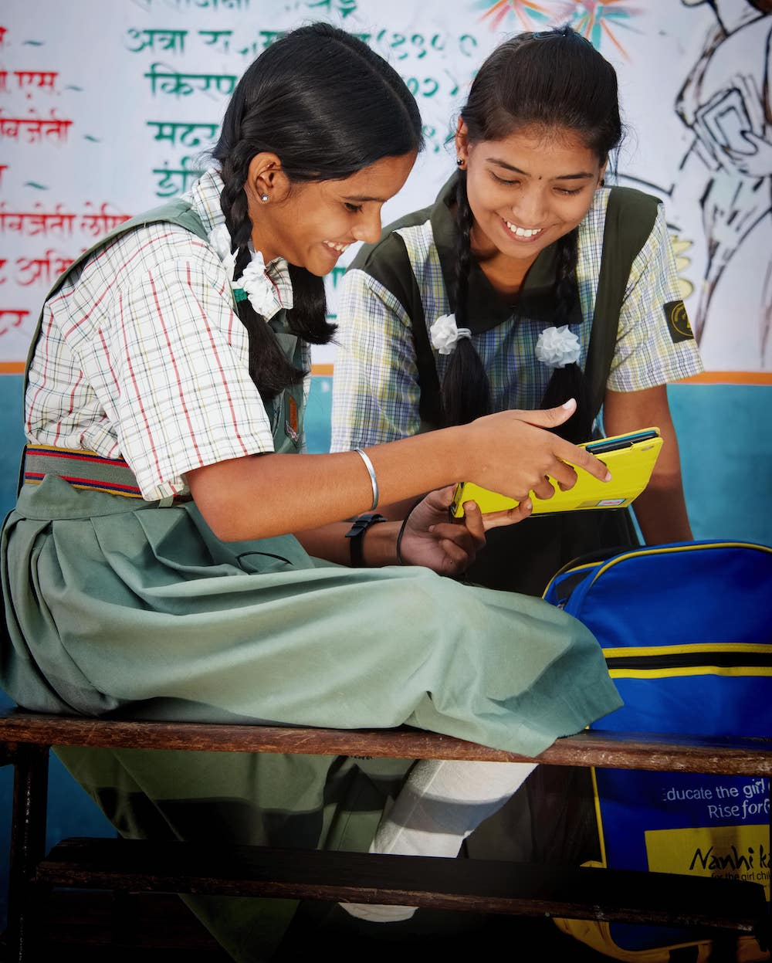
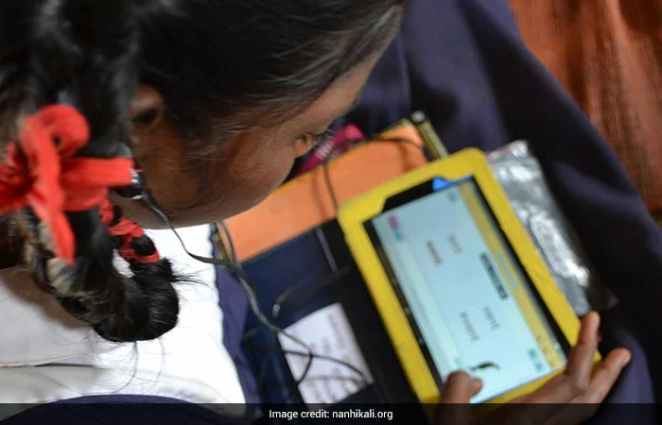
Notes:
We are thrilled to explore a potential strategic alliance with Nanhi Kali because we believe that our values and goals are closely aligned. Our startup, Financial Education Crew, is dedicated to empowering young girls in India with the knowledge and skills they need in order to make informed financial decisions and achieve their financial goals. We understand that financial education is an important part of overall education, and we aim to provide age-appropriate and engaging financial education that is tailored to the specific challenges and opportunities faced by young girls in India.
What sets us apart from other financial education providers in India is our differentiation focus strategy. We focus specifically on the unique needs and preferences of young girls in India, offering an age-appropriate curriculum, interactive learning features, personalized coaching, and community engagement. By focusing on a niche such as women and children, we can target our efforts and investments towards creating meaningful change and equipping the segment, one village at a time. This strategy also requires significant investments in new product features, branding, marketing capabilities, and the development of skills and competencies necessary for providing outstanding customer service.
We believe that a strategic alliance with Nanhi Kali would be mutually beneficial for both organizations. By partnering with us, Nanhi Kali can expand its focus beyond education to include financial education and empowerment. Our platform can serve as a valuable resource for Nanhi Kali's girls, complementing the existing education programs and helping them become financially literate and independent. In turn, our partnership with Nanhi Kali can help us reach more underprivileged girls in India and expand our reach and impact.
In addition to our shared values and mission, we believe that our differentiated approach to financial education makes us an ideal partner for Nanhi Kali as we are making it easier for young girls to learn and apply financial concepts. Our focus on women empowerment also aligns with Nanhi Kali's commitment to improving the lives of underprivileged girls and their families in India.
Through a strategic alliance with Financial Education Crew, Nanhi Kali can benefit from our expertise and resources in the financial education space. Our partnership can create a powerful impact by providing underprivileged girls with access to financial knowledge and skills that can help them break the cycle of poverty and achieve financial independence which is our absolute highest goal. Together, we can create a lasting change in the lives of young girls in India, empowering them to become confident, financially literate individuals who are capable of achieving their full potential.

Slide 19
Thank You
Emma Cohen - Ikenna Daniel Nwankwo - Lamis Salloum Yared - Rohan Upadhaya - Vaishnavi Pritam Veer

